Slide 1
Reimplementing Raster Intervals: A Detailed Study on Polygon Intersection Joins Dimitrios kyriakopoulos Dimitrios rontogiannis

Slide 2
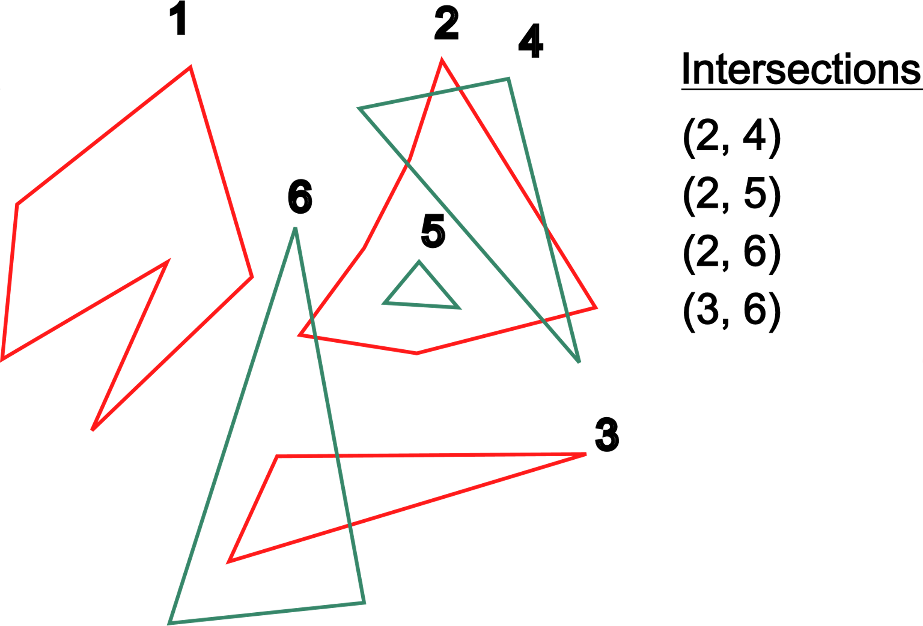
Recap
Two sets of spatial objects -> find all pairs that intersect
Applications in: Geographic Information Systems, computer graphics, synthetically constructed brain models etc.
Computationally expensive

Slide 3
pipeline

Slide 4
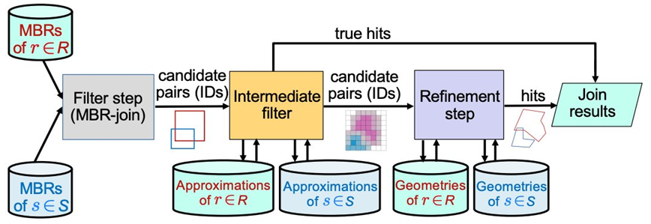
Pipeline

Slide 5
Minimum bounding rectangle filtering

Slide 6
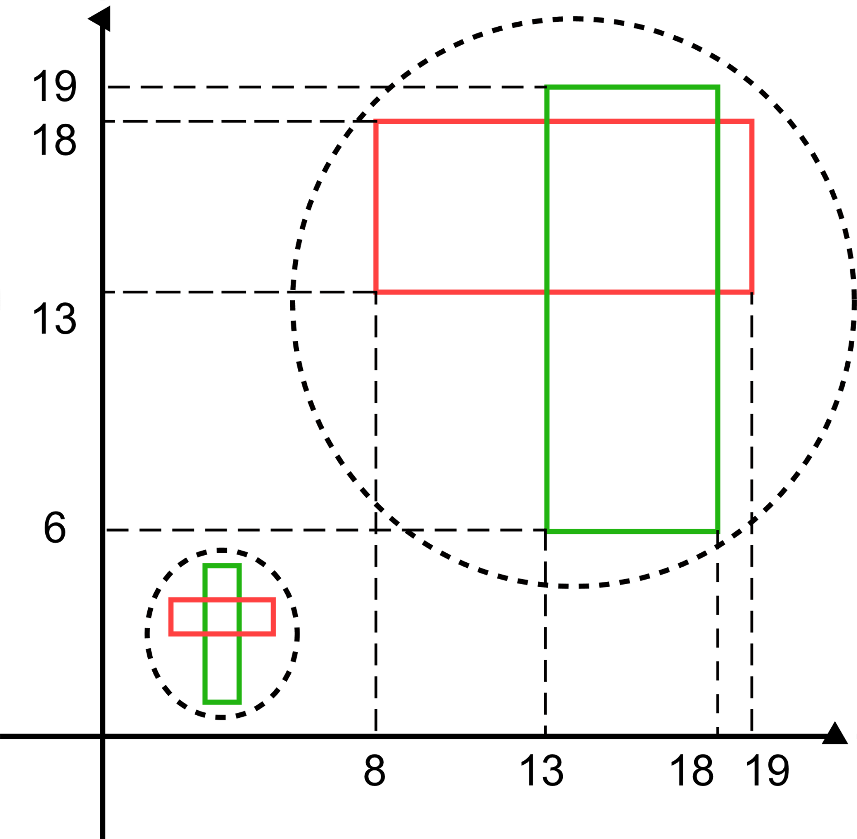
preprocessing
Find each polygon’s minimum and maximum x and y coordinates
Coordinate compression (intersections are preserved)

Slide 7
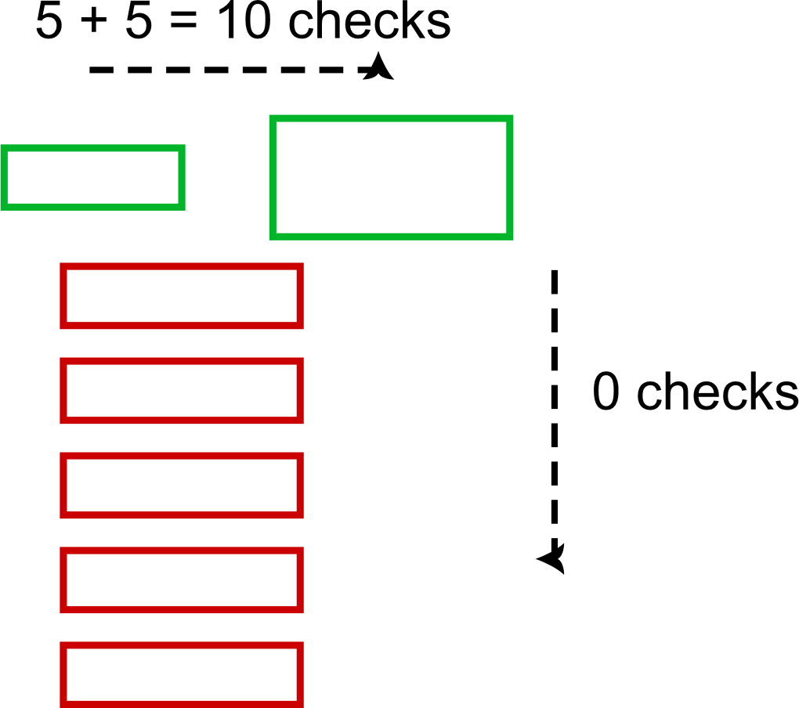
Feed forward plane sweep
When do rectangles intersect?
Sweeping line
Hit rectangle is checked with intersecting rectangles on sweeping axis
Number of pairs checked -> number of intersections on sweeping axis

Slide 8
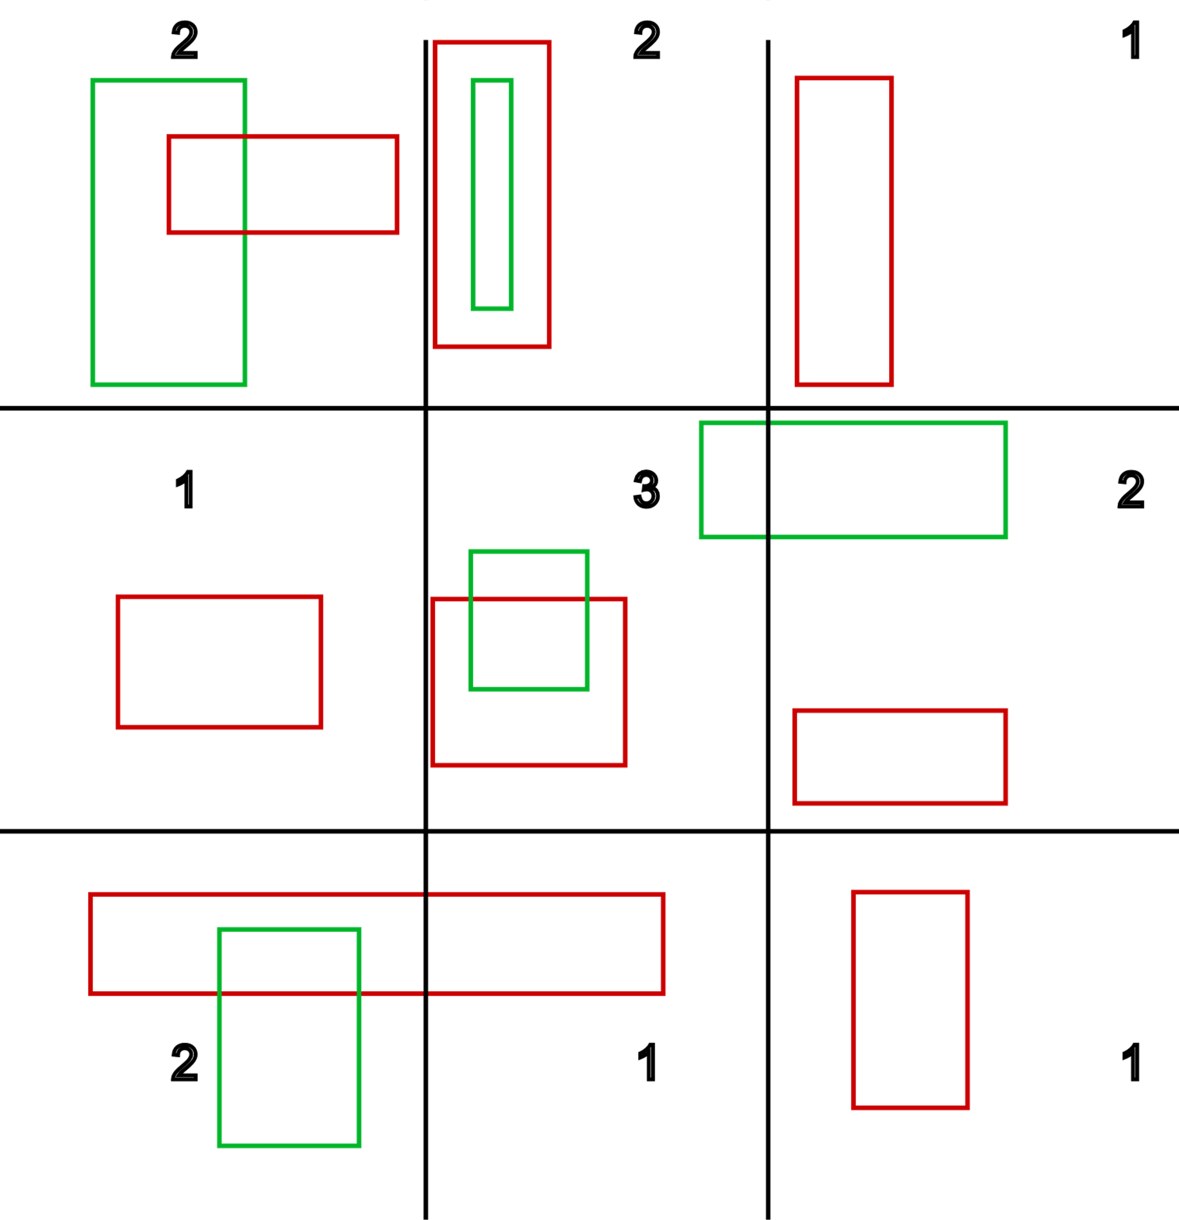
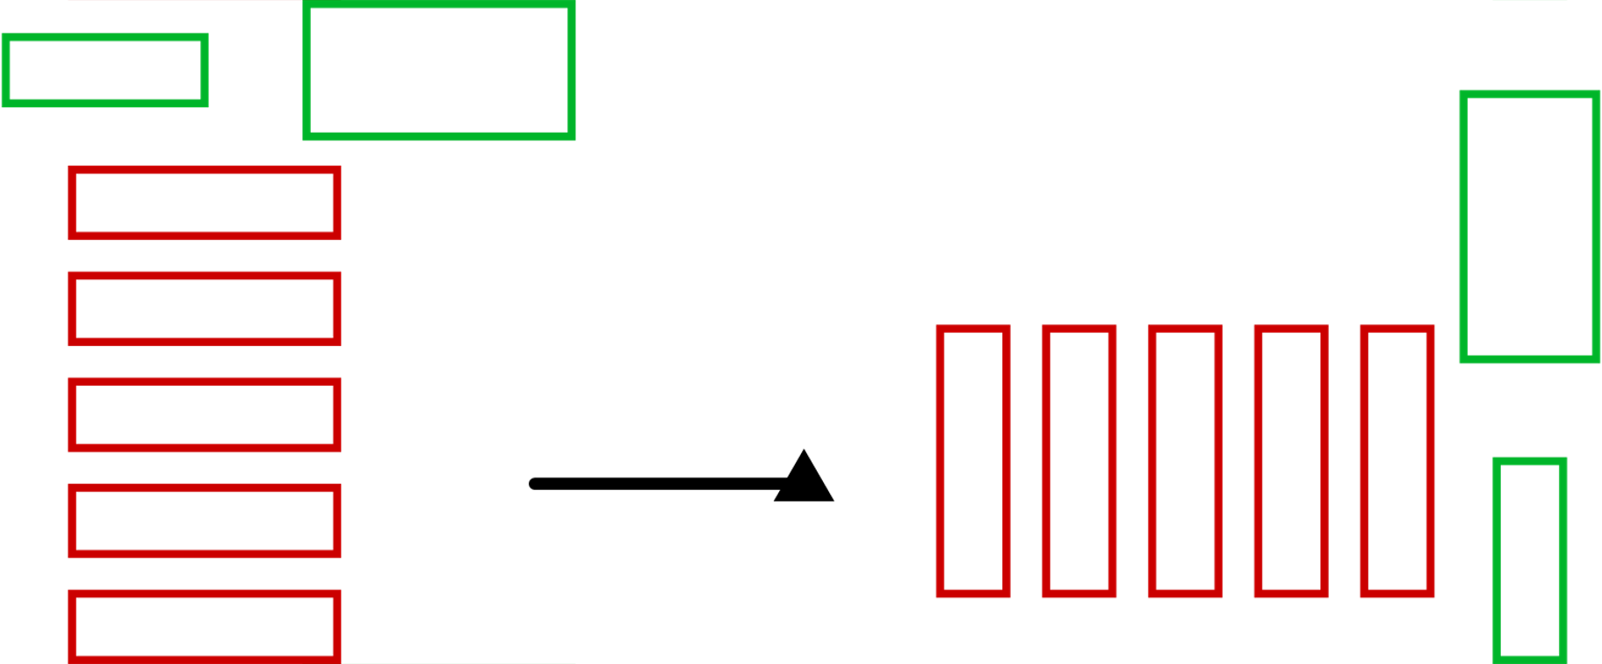
FEED FORWARD PLANE SWEEP
(Optimized)
Perform sweep on axis with less intersections
Partition plane and solve each subproblem in parallel

Slide 9
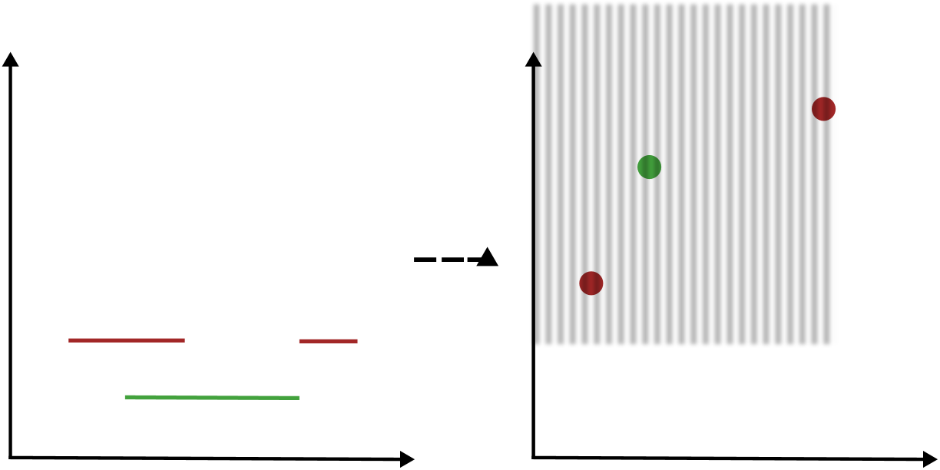
Best axis
Project rectangles on axis
Authors approximate intersections
We find exact number
Segments transformed to points
Query on halfplane
[1, y] x [x, +inf]

Slide 10
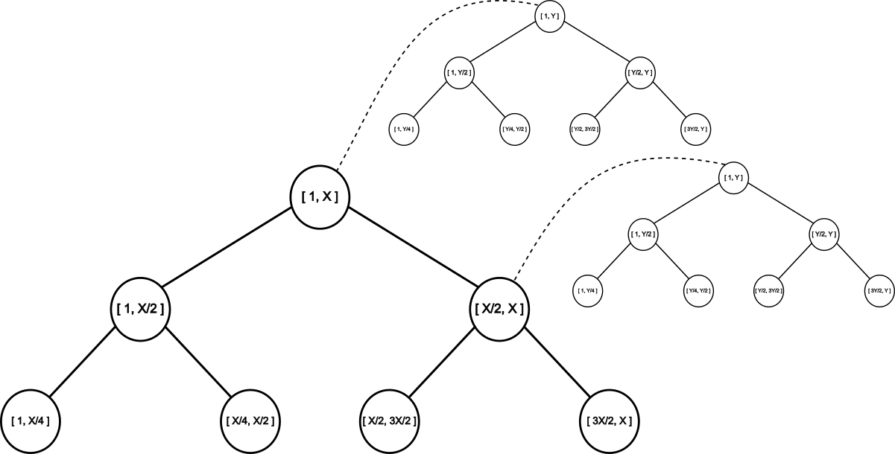
Dense scenario
Two novel algorithms for polygon id filtering
2d segment tree
Combined sweep algorithm

Slide 11
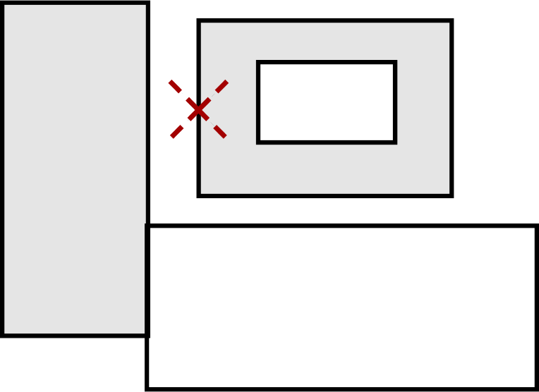
Missed inner intersections
Misses cases where a rectangle from one collection has only intersections with rectangles from the other collection that are completely inside it.
Sweep on both axis
Keep active intervals and query

Slide 12
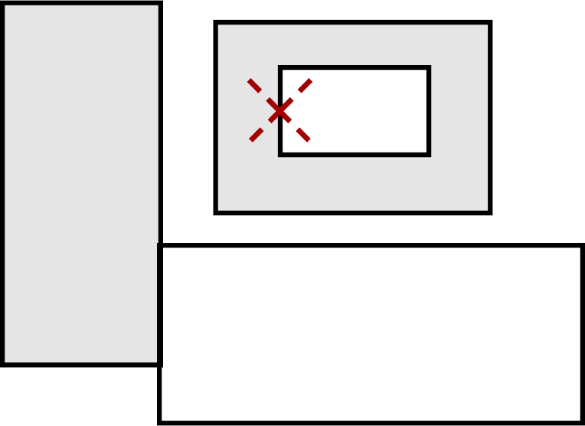
Missed outer intersections
Fails to identify a rectangle as intersecting if it is completely covered by other rectangles from the opposite set
Queries points in rectangle

Slide 13
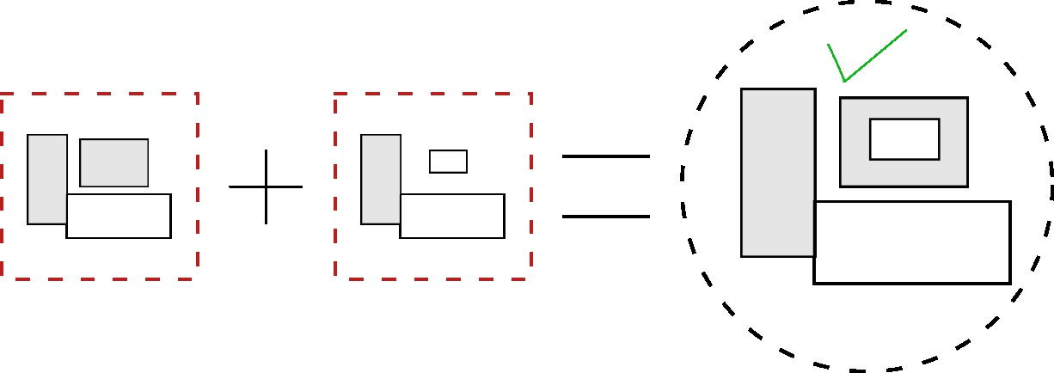
Combined algorithm

Slide 14
RASTERIZATION

Slide 15
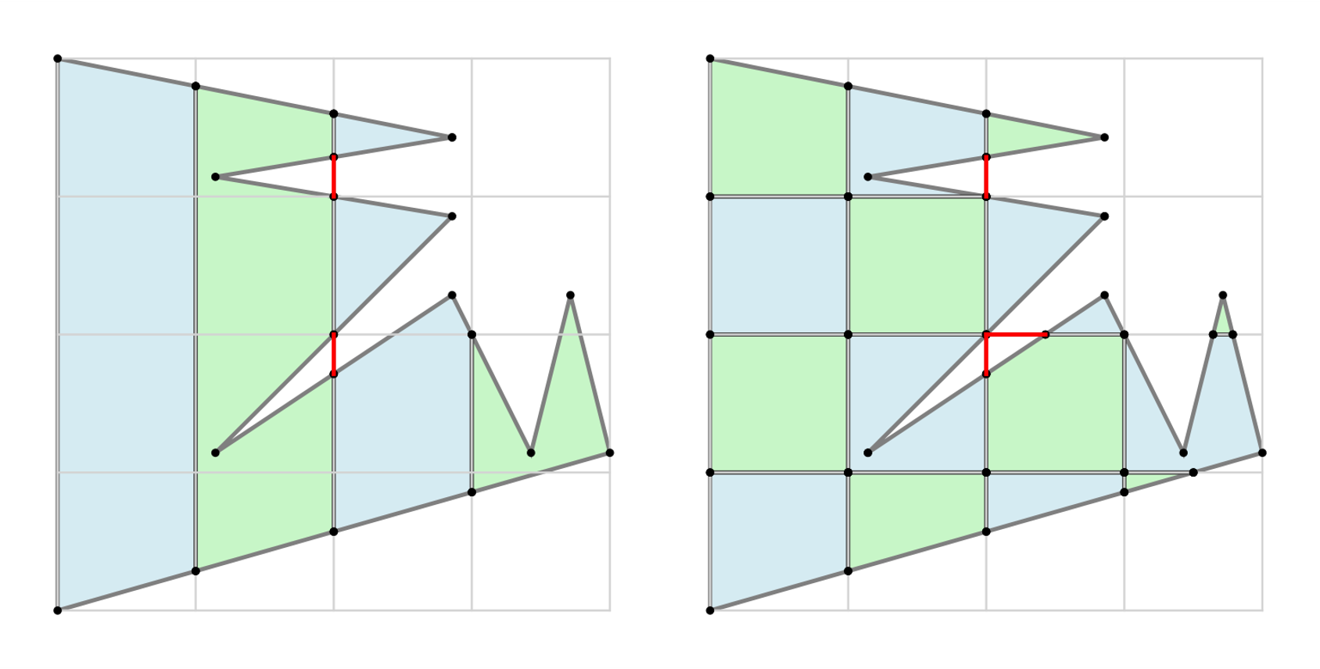

cLIPPING
Hodgman Clipping algorithm
Clips polygons by sequentially processing each edge of the clipping polygon
Well-suited for simple, convex polygon
Concave polygons may be displayed with extraneous lines
Weiler Atherton Clipping algorithm
Identify intersections and walk through vertices and intersection points to build new segments
Manages complex, concave polygon
Hodgman Clipping
Weiler Clipping
Notes:
Clip polygon w.r.t. cells of the 2Nx2N grid
First clipping the polygon against vertical grid lines from left to right.
The results from vertical clipping are then clipped against horizontal grid lines from top to bottom

Slide 16
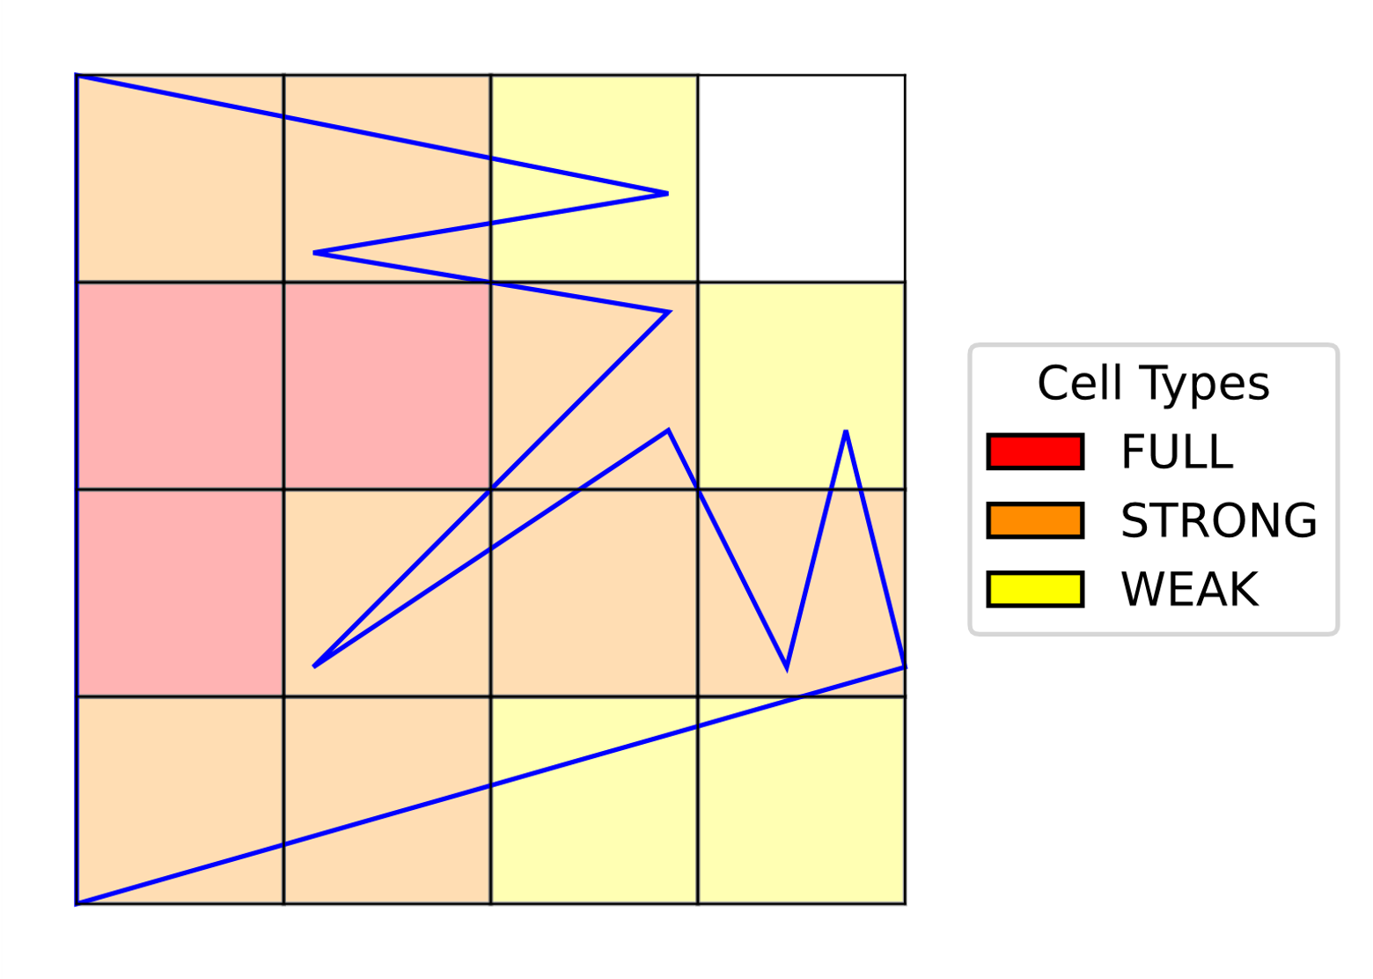
CELLS ENCODING
Classify each cell as full, strong, or weak based on the extent of overlap
Encode cell types differently based on the source of the object
 | input R | input S
Full | 011 | 101
Strong | 101 | 011
Weak | 100 | 010
3-bit type codes for each input dataset
 | Weak | Strong | Full
Weak | No | No | Yes
Strong | No | Yes | Yes
Full | Yes | Yes | Yes
Cells classification based on the
Do two objects intersect in a cell?
extent of overlap

Slide 17
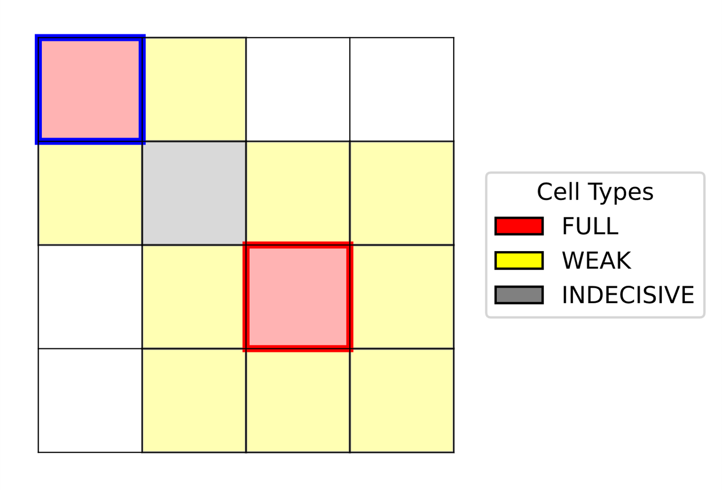
Ambiguity in Rasterization Process
Polygons separated by grid cell width intersect intermediate cell as point/line
Such cells are classified as weak, covering ≤ 50%
Logical AND of weak cell types is indecisive
Causes unnecessary, costly refinement steps
Consider extending binary representation from 3 to 4 bits for more accurate filtering
Intermediate cell classified as weak for both polygons

Slide 18
serialization

Slide 19
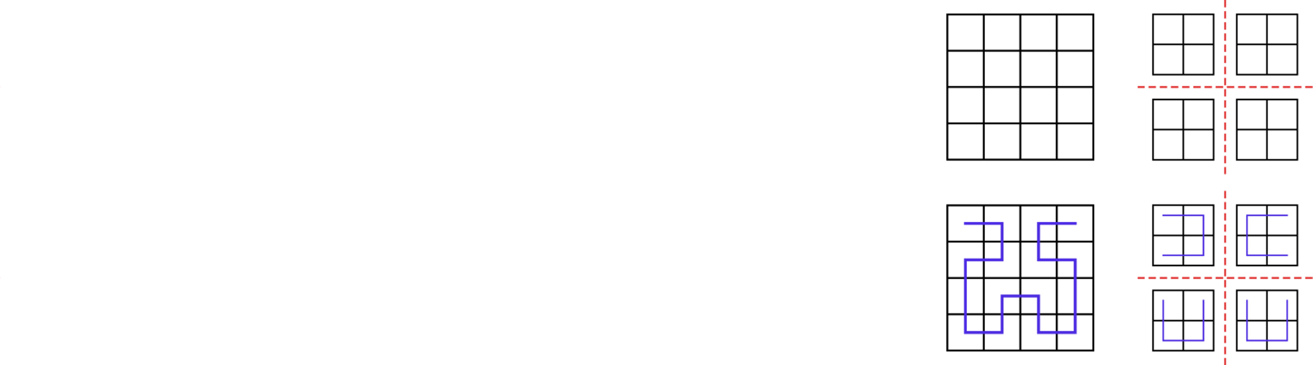
Hilbert curve
Points that are close in one-dimensional space are also close in the two-dimensional space

Slide 20
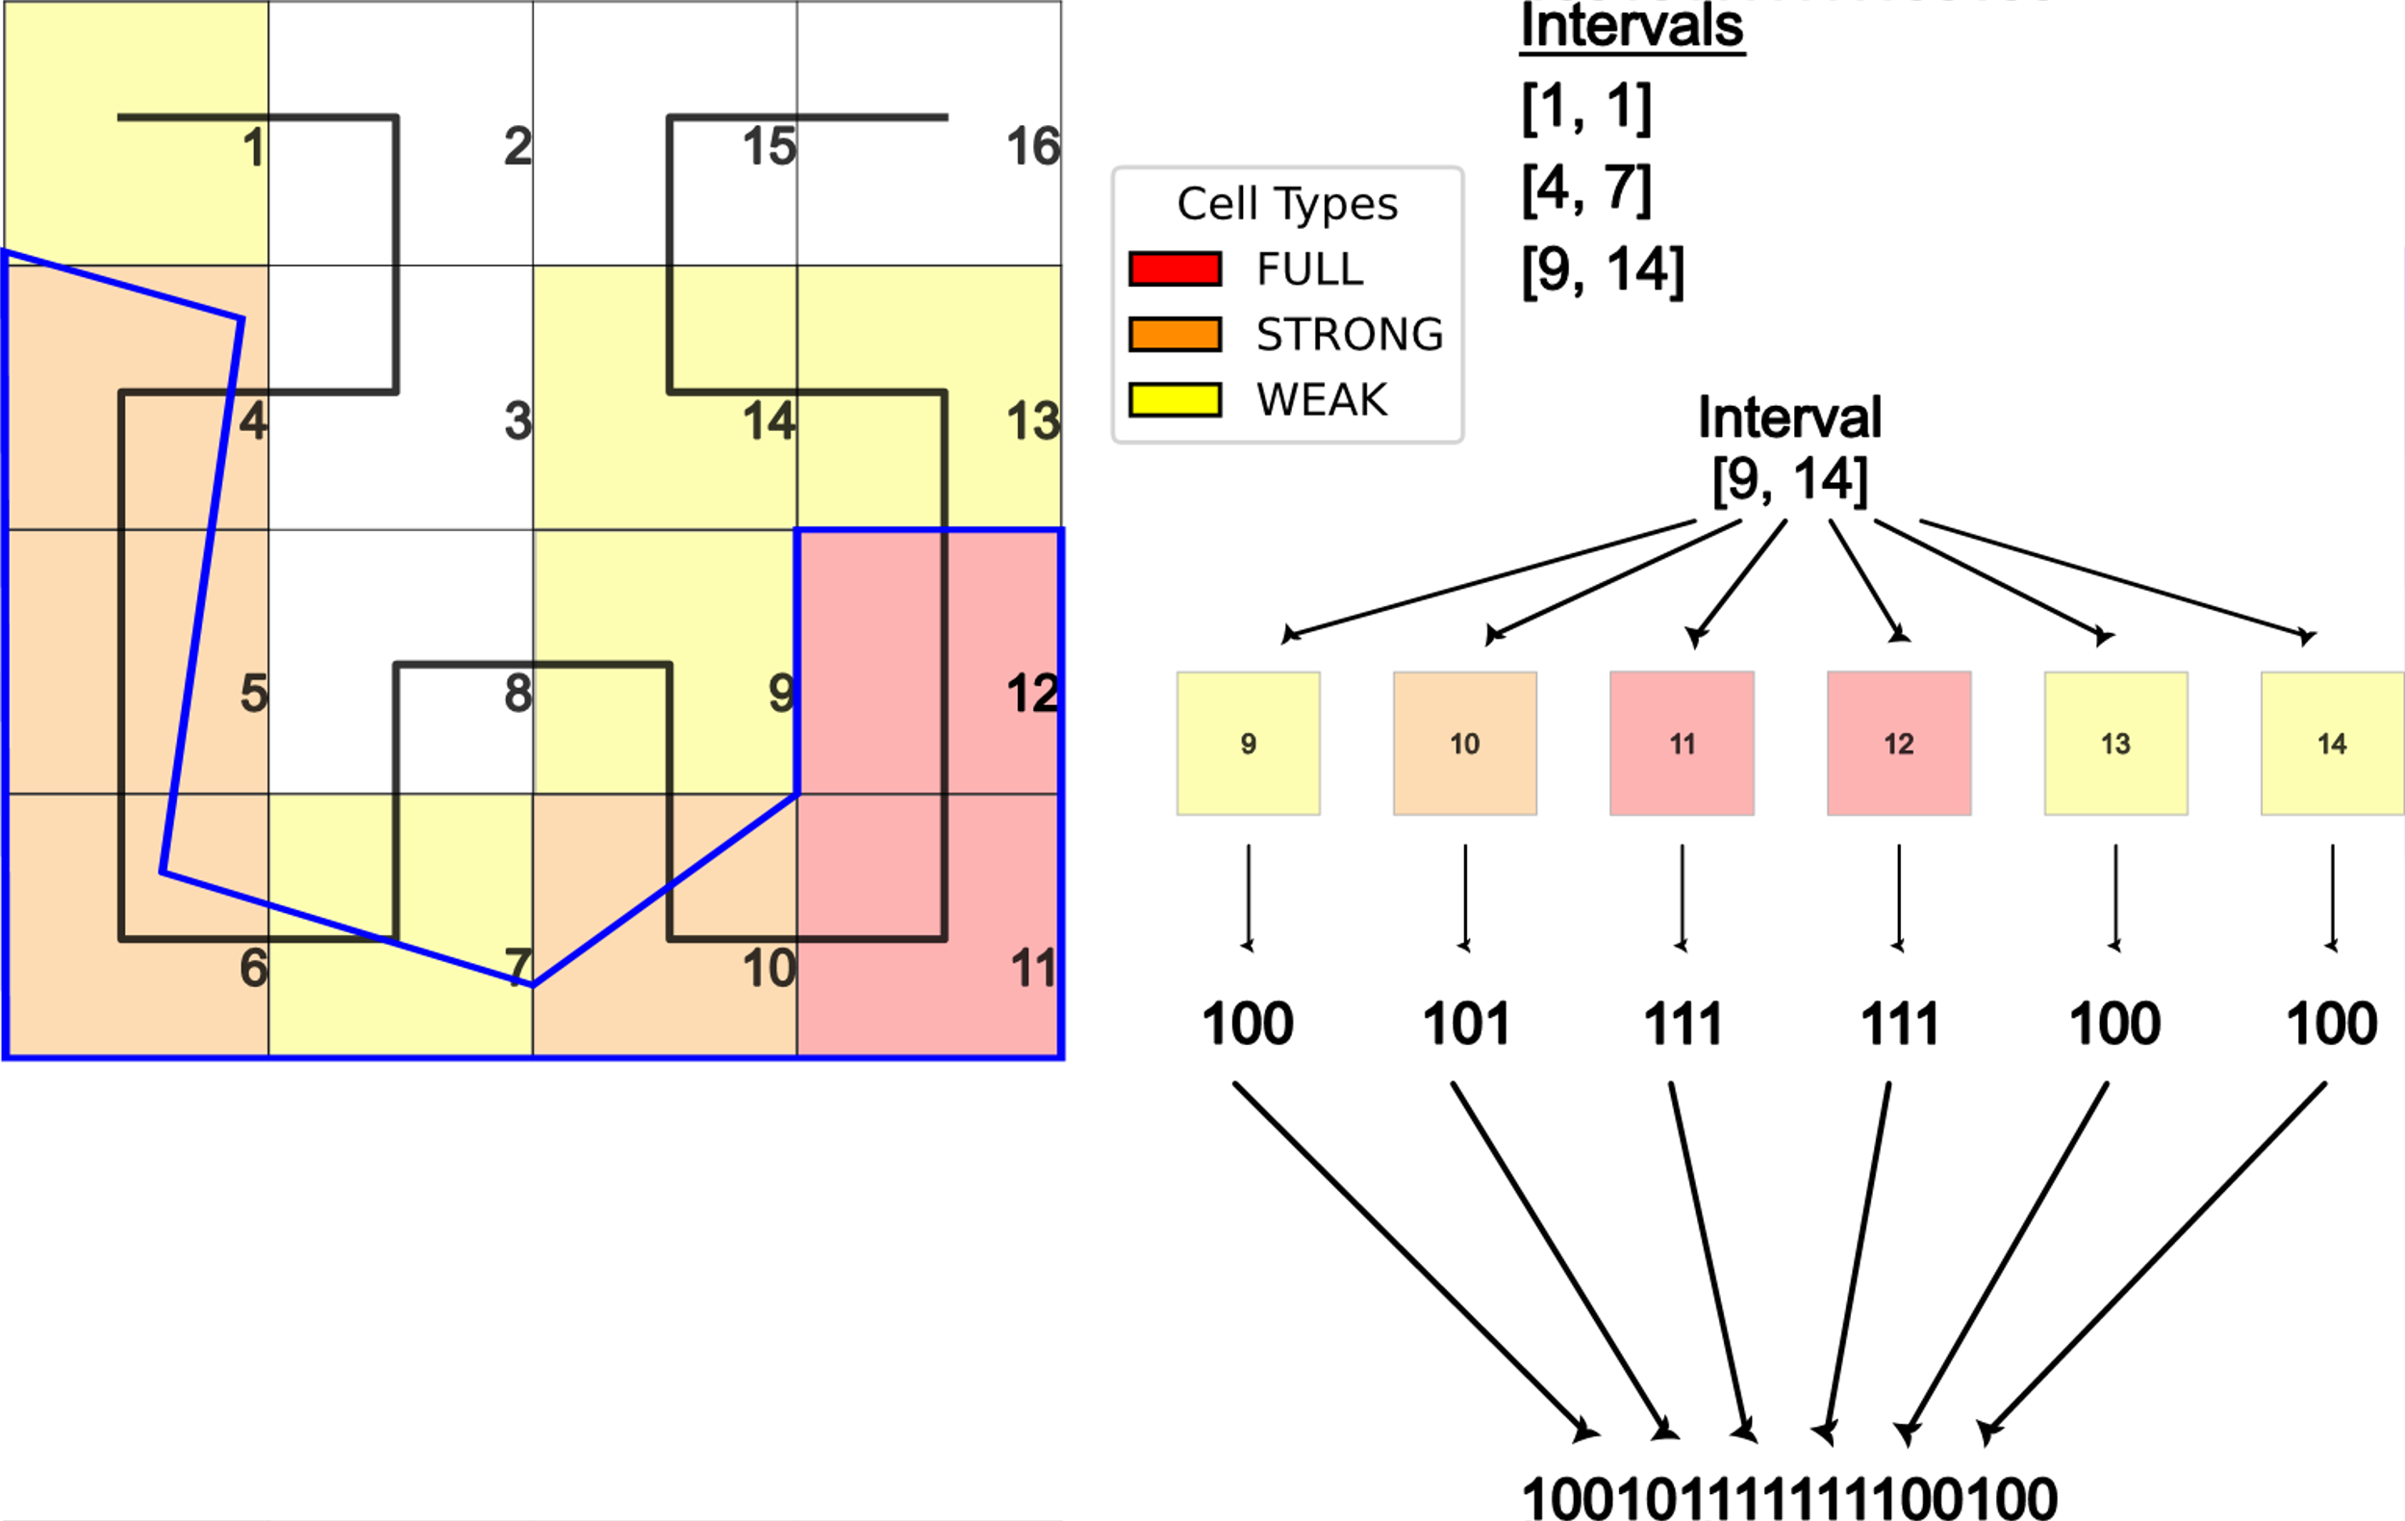
serialization
We use rasterized polygon information
Create intervals of continuous Hilbert values of the rasterized polygon and their corresponding bitmasks

Slide 21
Raster interval join algorithm

Slide 22
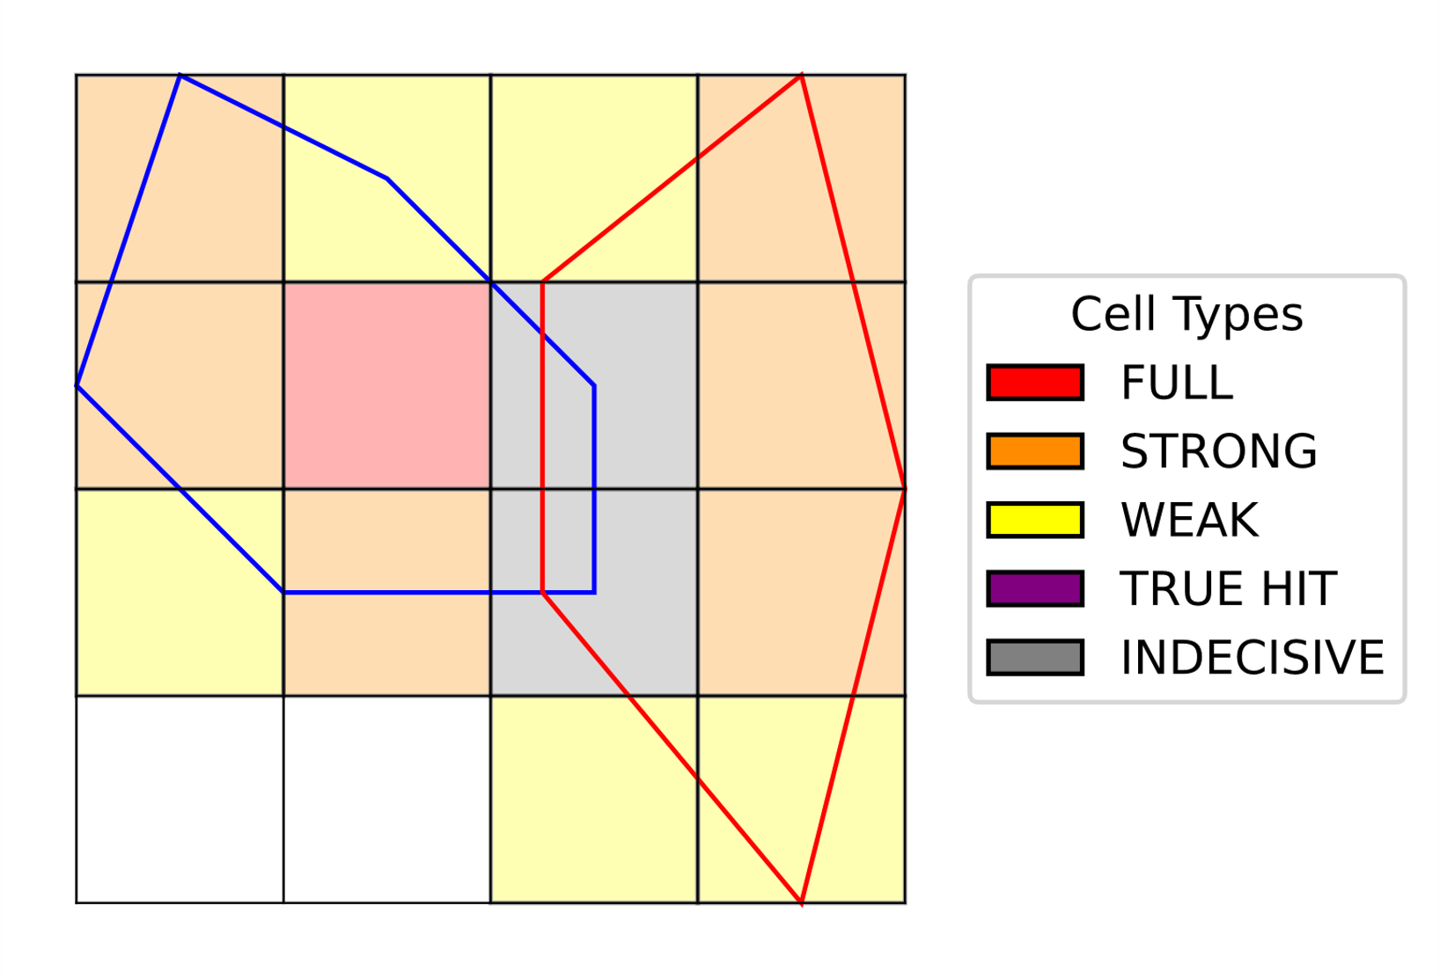
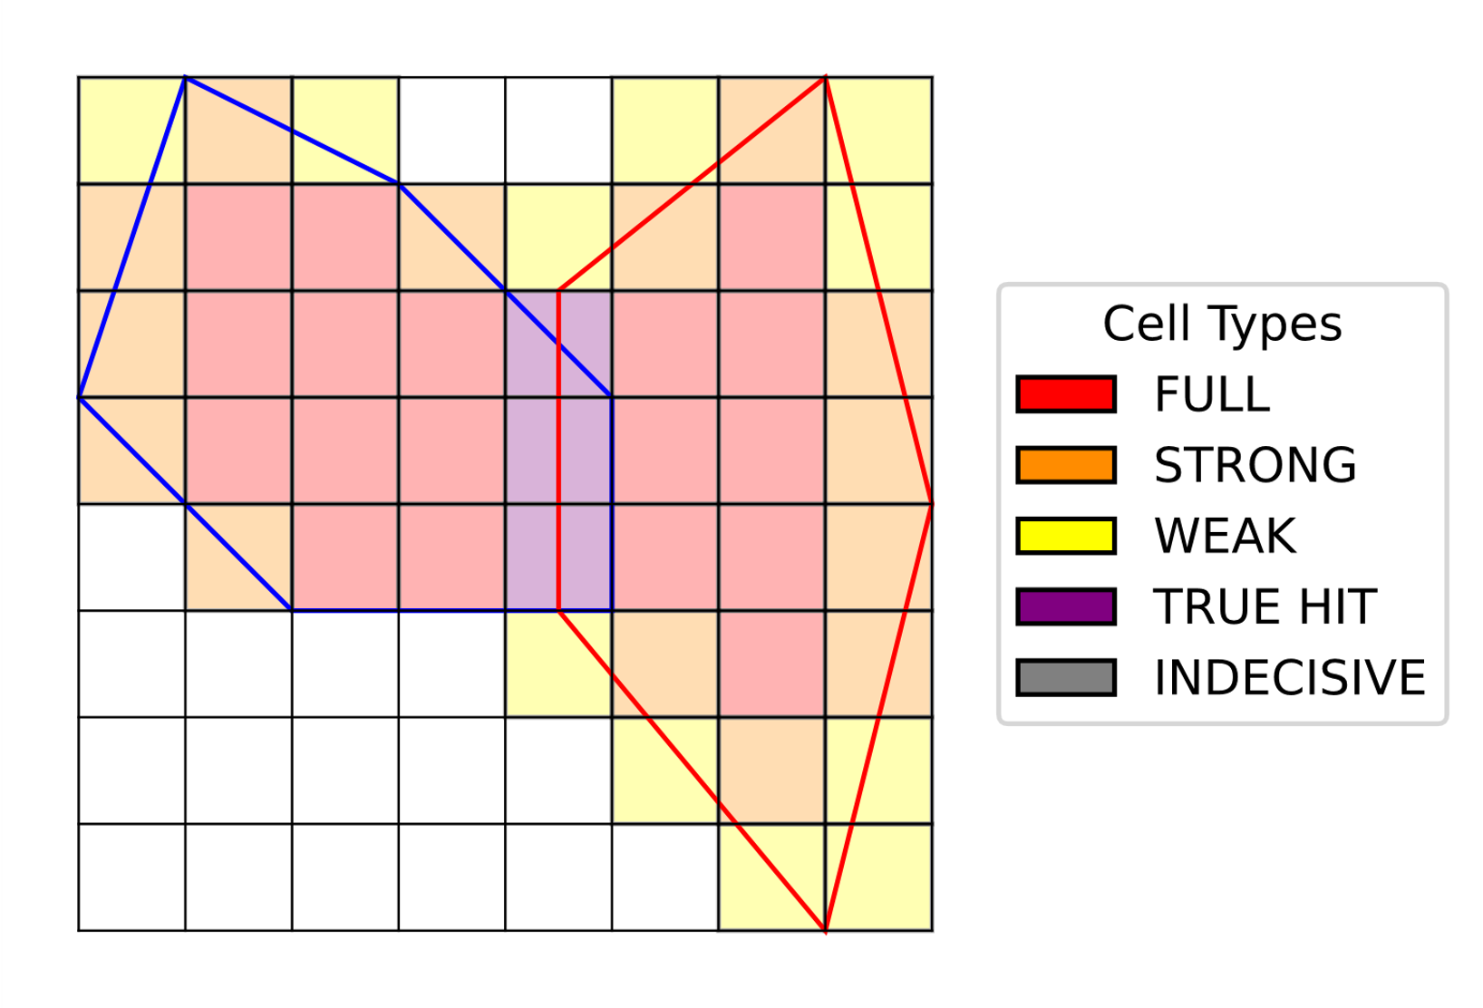
RI join algorithm
• 𝑟 and 𝑠 definitely intersect
• 𝑟 and 𝑠 definitely do not intersect
• we cannot conclude about the intersection of r and s
Raster join by cell type of 2 polygons in a grid 2²x2²
Raster join by cell type of 2 polygons in a grid 2³x2³

Slide 23
refinement

Slide 24
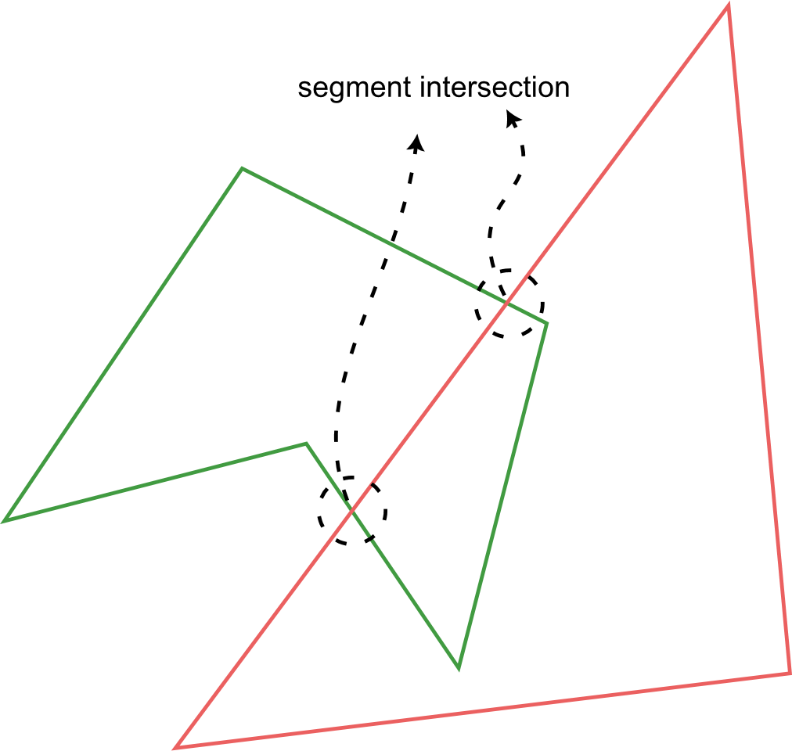
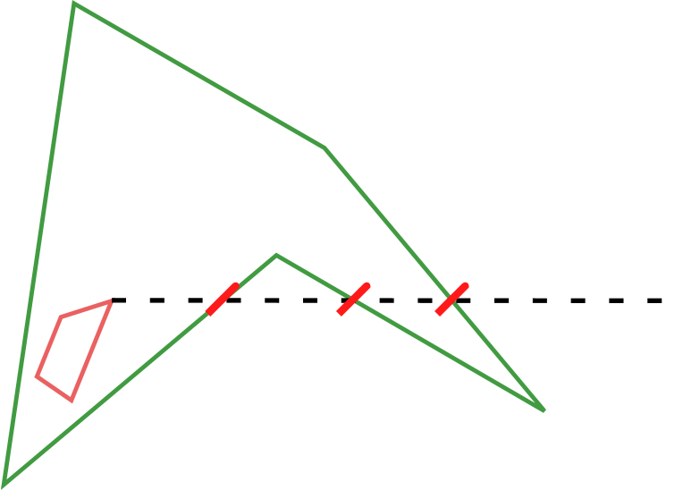
Intersection checks
Edge intersection
Point in polygon (ray casting)

Slide 25
Experiments

Slide 26
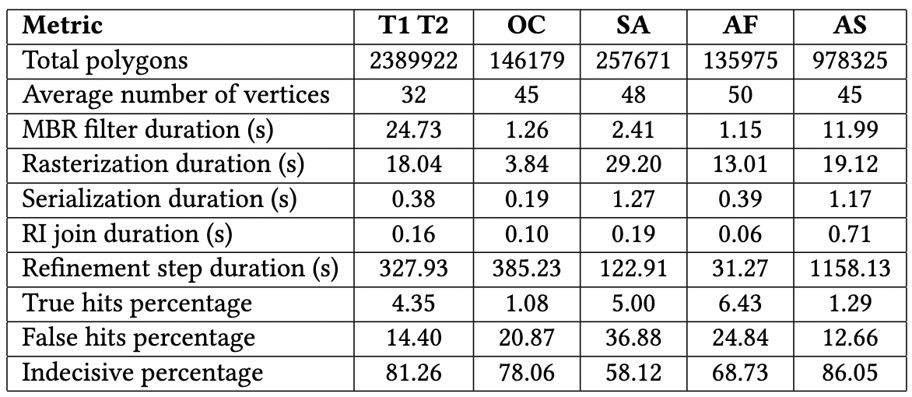
results

